Slide 1
The Laplacian spectrum of neural networks
Siemon C. de Lange
Marcel A. de Reus and Martijn P. van den Heuvel

Slide 2
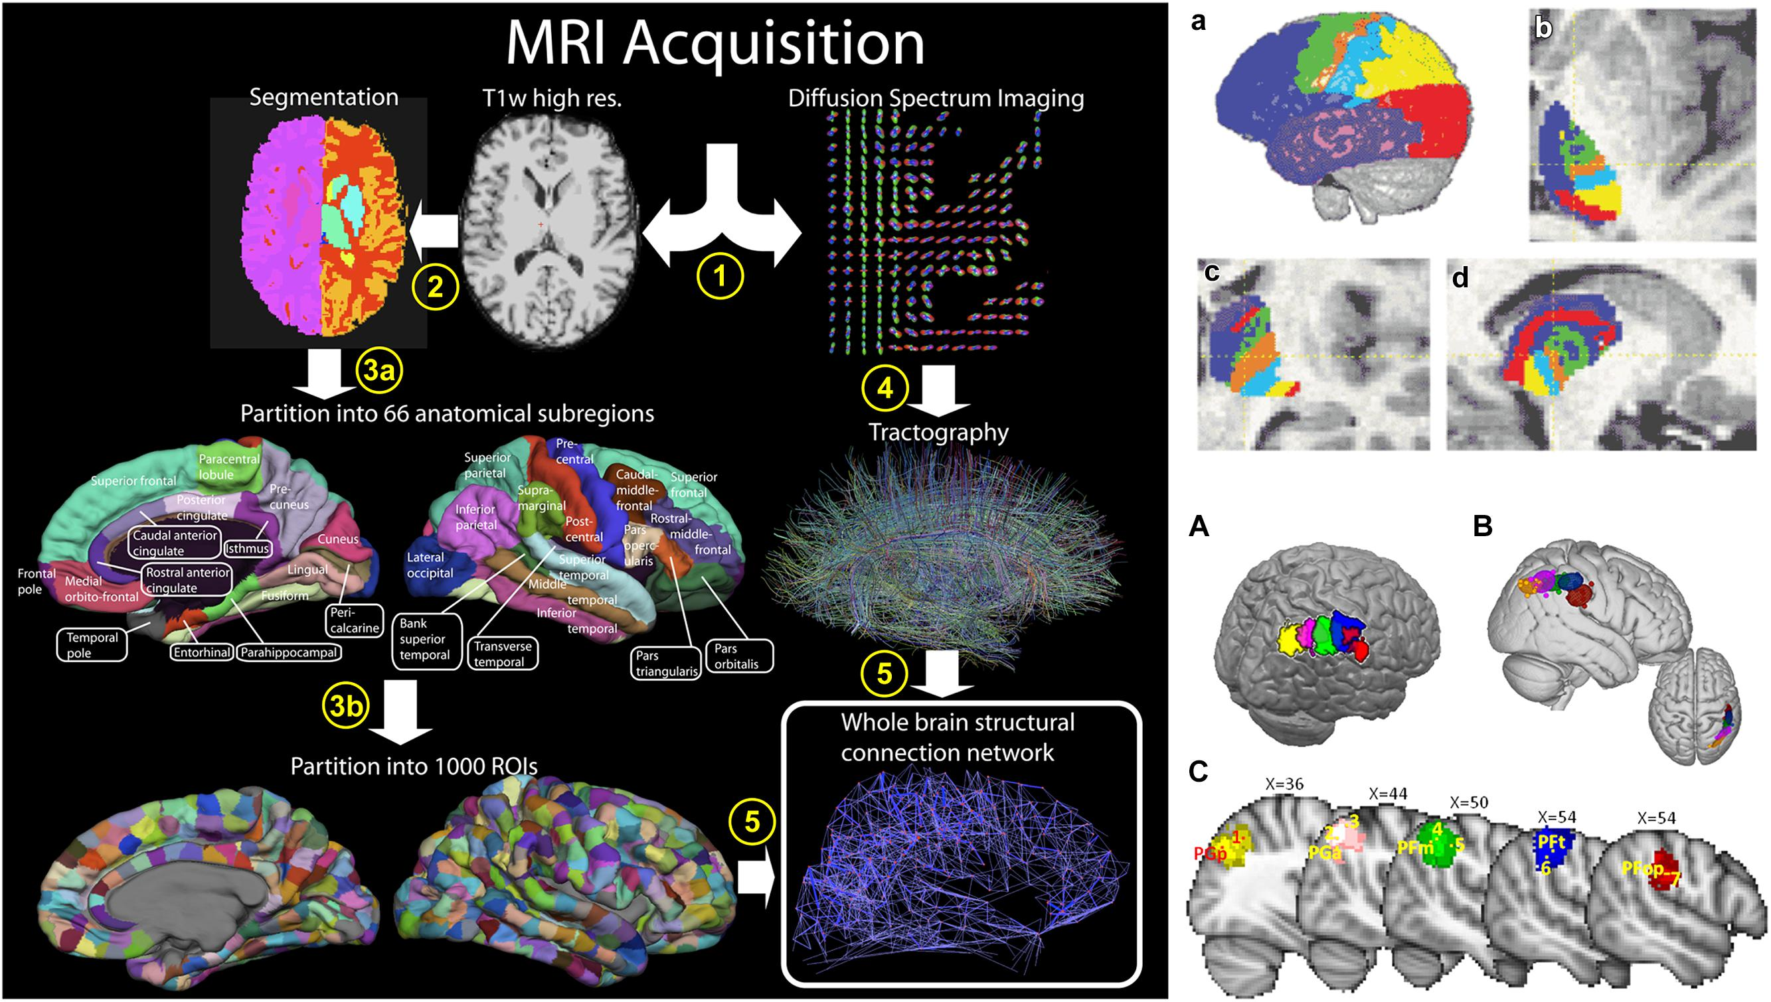
Structural Connectivity
Structural Connectivity
the connectivity pattern of neural system is formed by structural (anatomical) links between neural units
Macro level: brain ROIs linked by fiber pathways
Micro level: neurons or neuronal populations linked by synapses
Notes:
Anatomical connectivity
Diffusion MRI

Slide 3
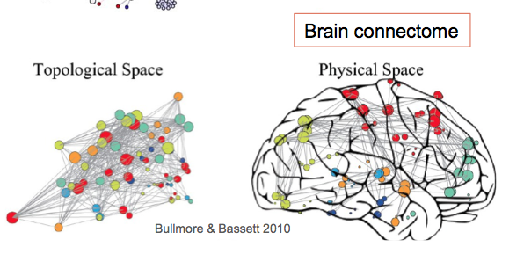
Network Analysis based on Graph Theory
Why Graph Theory
Quantitative description of Large-scale graph
Property of network at both individual and global level
Comparison between different networks
Notes:
Hundreds of nodes and thousands of edges

Slide 4
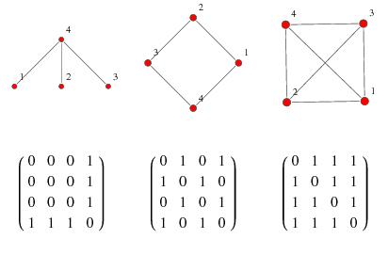
Basic in Graph Theory
What is a graph
Directed and Undirected
Binary and Weighted
Adjacent Matrix
Degree
The degree of a vertex is the number of connections or edges it has.
Clustering coefficient
the probability that the neighors of this vertex are also connected to each other.
The clustering coefficient is considered to be a measure of the local connectivity of a graph.
Notes:
Vertex, edge, neighbour

Slide 5
Graph Measures
Pathlength and efficiency
A shortest path between two nodes A and B is the path between A and B with the smallest number of edges.
Related to the idea of the average shortest path is that of global efficiency, which is the inverse of the average shortest path.
The local efficiency of a particular vertex is the inverse of the average shortest path connecting all neighbors of that vertex.
Centrality
Degree centrality
The betweenness centrality of a particular vertex is the fraction of shortest paths in the network that pass through this vertex.
Spectral centrality
Hub centrality
Modules
Subgraphs that consist of sets of vertices that are more strongly connected to each other than to the rest of the network
Triangle Motif

Slide 6
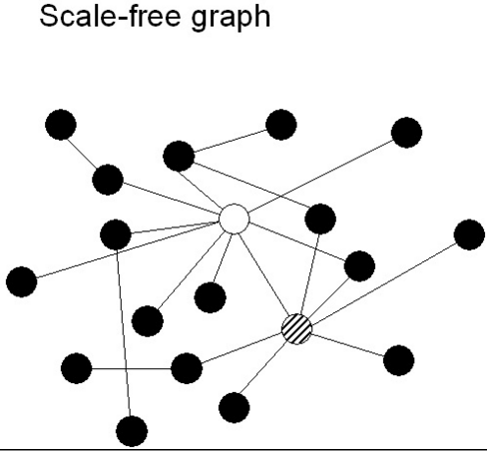
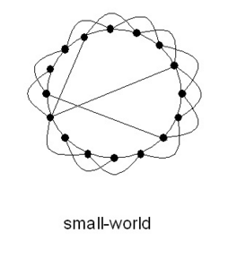
Network Models
Random Graphs (ER)
Small-world networks (WS)
High efficiency, high local connectivity, no hub, no module
Scale-free Networks (SF)
Presence of hub
Notes:
In a random graph G(V,E) edges between any pair of vertices exist with a probability p.
A small-world network is a type of mathematical graph in which most nodes are not neighbors of one another, but most nodes can be reached from every other by a small number of hops or steps. Specifically, a small-world network is defined to be a network where the typical distance L between two randomly chosen nodes (the number of steps required) grows proportionally to the logarithm of the number of nodes N in the network.

Slide 7
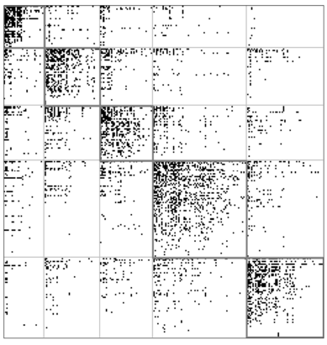
Three Neural Network From Literature
Macaque
The connectivity dataset of the macaque was based on tract tracing studies collected in the online Collation of Connectivity data on the Macaque brain, which describes macroscopic white matter projections between cortical regions of the macaque cortex.
The connection matrix in this study excludes subcortical areas (thalamus, basal ganglia and brainstem) and includes only connected areas. The connectivity data was converted to an unweighted, undirected network, with 6108 connections and 10.5% density
Previous Analysis
Highly clustered connectivity
Short path length
High global efficiency
High local efficiency
Similarity to small-world graph

Slide 8
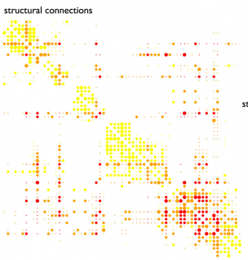
Three Neural Network From Literature
Cat
The connectivity dataset cat cortex 65 cortical areas connected by 1139 directed weighted. Three connections strengths were distinguished: weak connections having weight 1, medium strength connections with weight 2 and strong connections with weight 3. In this study, the dataset was converted to a binary, undirected network, including 730 unweighted, undirected connections with a total density of 35.1%.
Previous Analysis
Highly clustered connectivity
Small network size compared with other neural networks
High global/local efficiency
Similarity to small-world graph

Slide 9
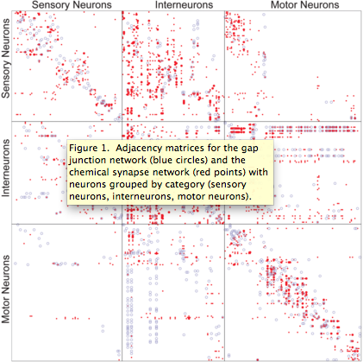
Three Neural Network From Literature
Caenorhabditis elegans
The connectivity dataset of the C.elegan originally have 279 neurons, of which 274 were included in this study. Five neurons were excluded as they had not at least one in and one outgoing connection. The connectivity matrix was transformed to an undirected, unweighted network having 2253 undirected connections and a density of 6.02%.
Previous Analysis
Central neurons with large degree
High clustering coefficient
Similarity to small-world graph

Slide 10

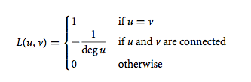
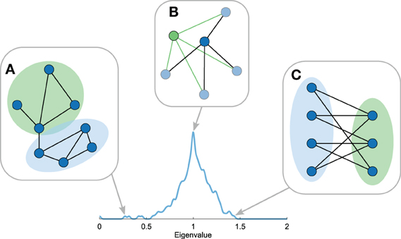
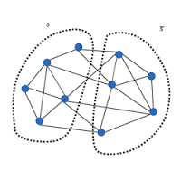
Spectral Analysis
Laplacian Matrix
Spectrum of Laplacian Matrix
Additive effect of each component
Interpretation of eigenvectors and eigenvalues
Notes:
Each eigenvector describes a unique bisection of the network by assigning a positive or negative value to each node, the associated eigenvalue λi describes the inverse diffusion time of this division to the stationary state
Intramodule connection vs intermodule connection

Slide 11
Result: Small eigenvalues
Second smallest eigenvalues
smaller eigenvalues low diffusion rate, indicating a large proportion of intramodule connections and a low number of intermodule connections
The best possible cut into two modules
Eigengap
i eigenvalues divide the network into i communities
Largest eigengap suggest possible number of communities for the optimal division
Notes:
Convoluted with guassian kernel

Slide 12
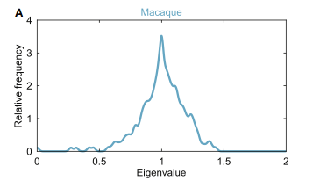
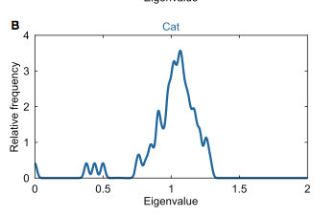
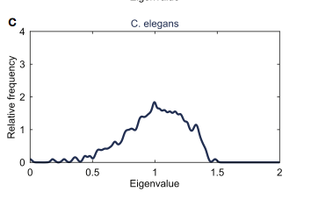
Result: Small eigenvalues
 | Macaque | Cat | C.elegans
2nd smallest eigenvlaue | 0.2718 | 0.3782 | 0.1818
Comparable random graph | 0.61 (0.06) | 0.6937 (0.0134) | 0.5438 (0.0142)
Largest eigengap | 0.1153 | 0.2512 | -
Suggested community# | 5 | 4 | -
Notes:
Convoluted with guassian kernel
smaller eigenvalues indicate longer diffusion times, indicating a large proportion of intramodule connections and a low number of intermodule connections

Slide 13
Result: The largest eigenvalue
Bipartiteness
A network is said to be (fully) bipartite if its nodes can be divided into two groups in such a way that nodes within the same group are not connected.
The largest eigenvalue
Level of bipartiteness
If the graph contain a lot of odd cycles, the largest eigenvalue should be small
Notes:
Convoluted with guassian kernel

Slide 14
Result: The largest eigenvalue
 | Macaque | Cat | C.elegans
The largest eigenvlaue | 1.4341 | 1.2875 | 1.4827
Comparable random graph | 1.3927 (0.0558) | 1.3319 (0.0119) | 1.4613 (0.0136)
P-value | 0.2291 | >0.9 | 0.0574
Notes:
1 Additional visual inspection of the eigenvector linked to the largest eigenvalue, presented with respect to communities as identified in Harriger et al. (2012), showed that this eigenvector was localized on two of the five structural modules, identified to include frontal/orbitofrontal and temporal regions
2 weaker bipartiteness in the network of the cat cortex, indicating more odd cyclic motifs
3 Additional visual inspection showed that the eigenvector associated with this eigenvalue was restricted to one of the four communities identified (Newman, 2006). This community included mostly ventral cord motor neurons, indicating that this class constitutes a relative high bipartite community.

Slide 15
Result: Eigenvalues near 1
Eigenvalues = 1
Duplication of node
Eigenvalues near 1
Duplication of vertex
Symmetric
Other density peak
Duplicated motif
The presence of eigenvalues with high multiplicities or eigenvalues at equal distances to 1 may provide an indication of local organizations resulting from recursive motif manipulations.
Notes:
Convoluted with guassian kernel

Slide 16
Result: Eigenvalues near 1
All three neural networks showed a peak around one, suggesting traces of node duplication.
peaks around one revealed to be rather symmetric, indicating traces of edge duplication in the networks.
Symmetry was most clearly seen in macaque and cat network and to a lesser extent in the C. elegans neural system, indicating higher levels of duplication in the networks of the macaque and cat compared to that of the C. elegans.
The spectra showed no other clear peaks indicative of recurrent addition of motifs.
Notes:
Convoluted with guassian kernel
smaller eigenvalues indicate longer diffusion times, indicating a large proportion of intramodule connections and a low number of intermodule connections

Slide 17
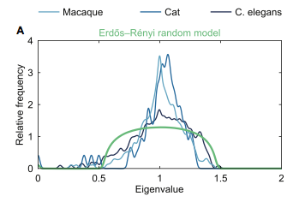
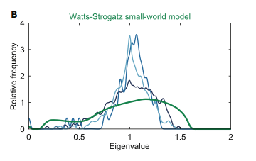
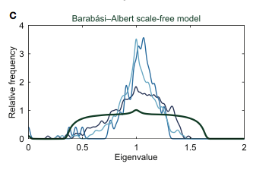
Compare Neural Networks with Network Models

Slide 18
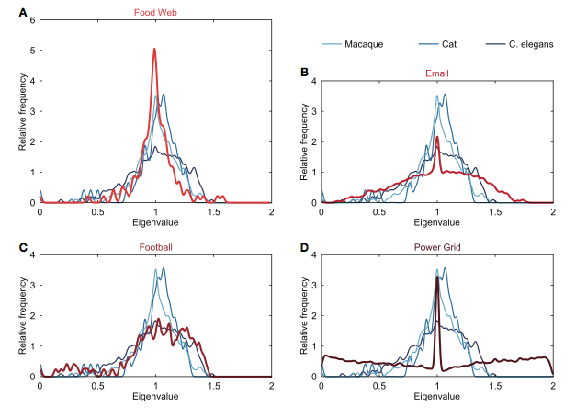
Compare Neural Networks with Empirical Networks
Notes:
Food chain in florida during wet season
Email interchange network
Football web
An edge represents a power supply line in western states. A node is either a generator, a transformator or a substation.

Slide 19
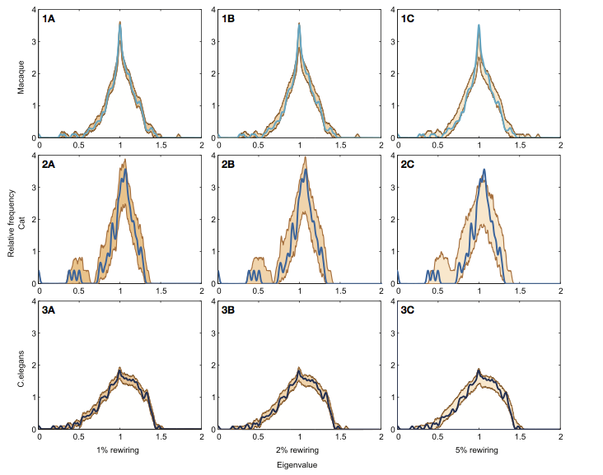
Result: Robustness
Notes:
Rewiring 1% 2% 5% edges, 1000 rewired data
1 limited effect, band shows similar shape of spectrum
2Careful interprate eigenvalues with small spikes
3 network size

Slide 20
Summary
Laplacian spectrum of different neural networks showed high level of similarity on several characteristics.
No clear overlap between neural spectra and the spectra of established network models
Small perturbation to the neural networks have only limited effect on the neural spectra.
Neural network has a relatively unique shape of the spectra, suggesting that they may form, a type of special network class.

